Slide 1
Unix Final Project
By Alianna Card, Kene Maduabum, Nolan Haag, and Blade Hagman

Slide 2
Linux Installation Steps on an External Drive

Slide 3
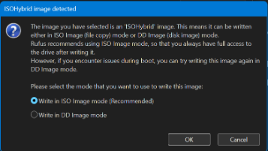
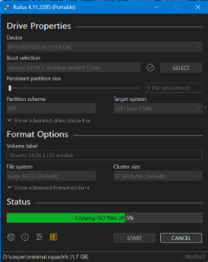
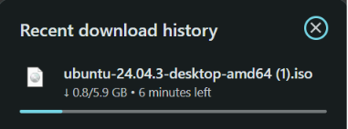
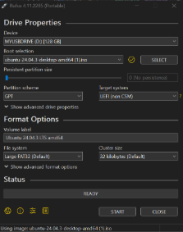
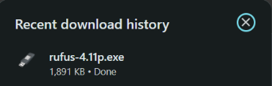
Creating a Bootable USB with Rufus
Download the ISO file and Rufus
Select the following settings to create a bootable USB
After the correct settings are selected, press START. Be sure to write the image in ISO mode.

Slide 4
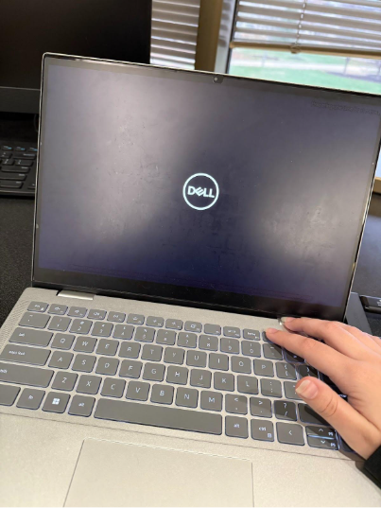
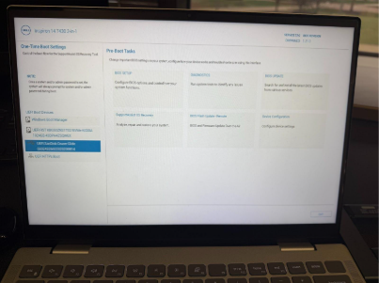
Boot from the USB
Restart the computer and press F12 to pull up the one-time boot menu
Select the USB from the boot menu

Slide 5
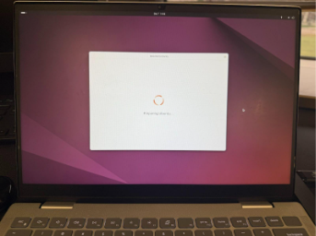
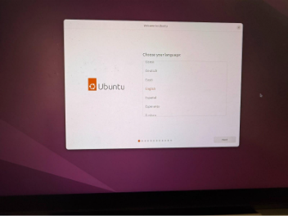
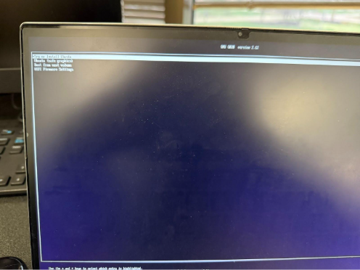
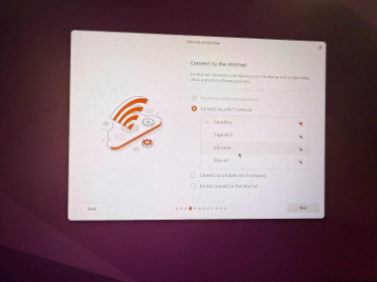
Installing Linux
Set up Ubuntu (language, keyboard layout, wifi)
Choose Try or Install Ubuntu from the menu

Slide 6
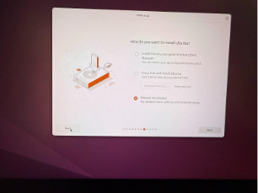
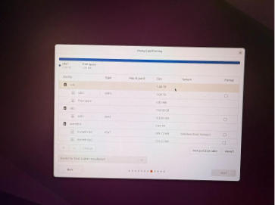
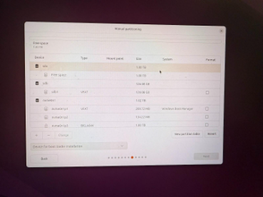
Installing Linux
Choose Manual Installation when installing
Identify the correct drive and delete current partitions

Slide 7
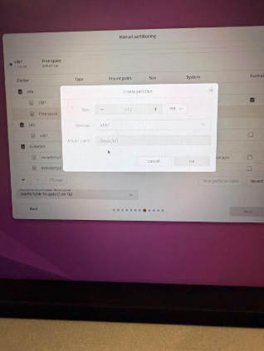
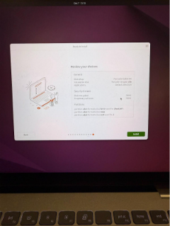
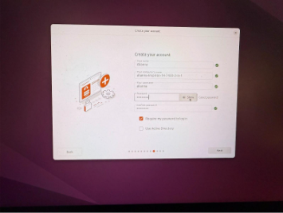
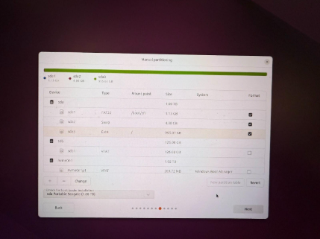
Installing Linux
Create account and review choices
Create new partitions: Boot, Swap, and Root

Slide 8
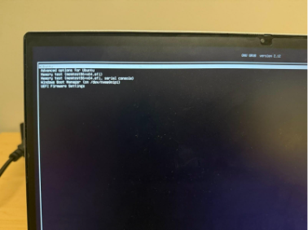
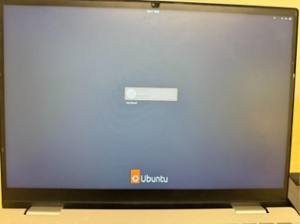
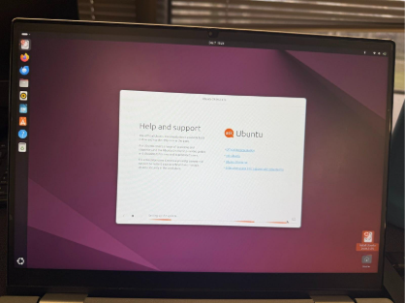
SWOT
COMPANY NAME
Installing Linux
Wait for Ubuntu to install
Verify Installation was successful

Slide 9
Customizations

Slide 10
Why We Chose Each Customization
Customization 1: KDE Plasma Desktop Environment
Customization 2: GNOME Software
First, this customization seemed relatively simple to install as it could be installed through APT. Also, GNOME had some good general-purpose apps and a good store.
The KDE Plasma Desktop environment looks similar to windows, which is familiar to everyone on the team, making it a good customization to choose. Additionally, it was relatively easy to install in the terminal.

Slide 11
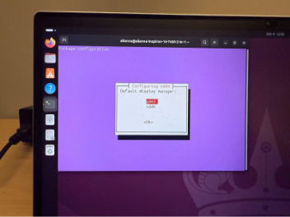
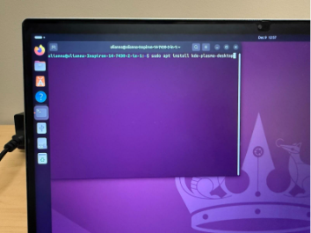
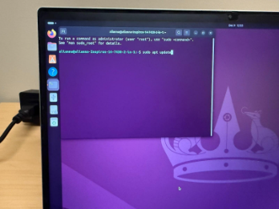
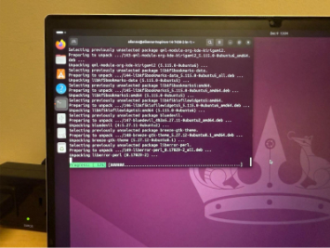
Installing KDE Desktop
Choose gdm3 as the default display manager and wait for it to download
First, run sudo apt update in the terminal
Then, sudo apt install kde-plasma-desktop

Slide 12
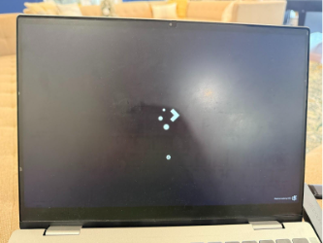
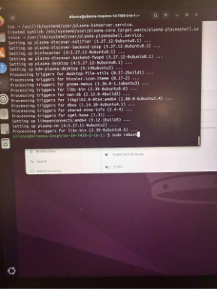
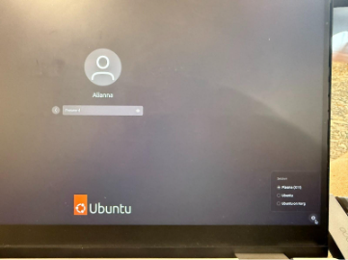
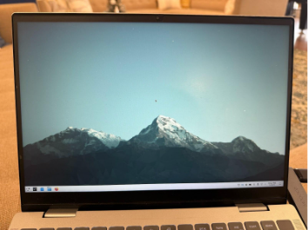
Installing KDE Desktop Cont.
Wait for the system to start and observe the changed appearance.
Run sudo reboot to test the installation
Choose plasma from the options before logging in

Slide 13
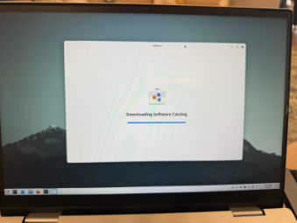
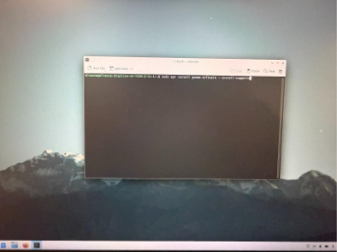
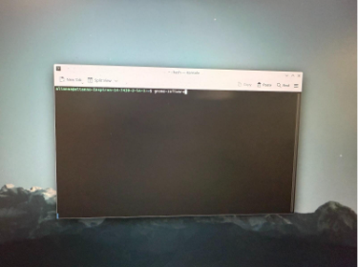
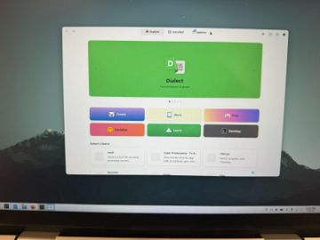
Installing GNOME Software
After running the previous command, the GNOME Software window should appear
Run sudo apt install gnome-software –install-suggests in the terminal
Run gnome-software to verify installation

Slide 14
SWOT
COMPANY NAME
Script Descriptions
icon.sh
cronjobs.sh
create_backup.sh
update_pachages.sh
Allows users to select scripts and an image to create a desktop file to easily run scripts like any other desktop application.
This script provides a comprehensive scheduling system for automating Linux tasks using cronjobs. It presents users with a graphical interface to schedule predefined jobs [like - create_backup.sh (directory compression), update_packages.sh (system package updates), or update_network.sh (network configuration updates)]. The script guides users through selecting the date, time (with 12-hour AM/PM format for user convenience), and recurrence pattern (daily, weekly, monthly, or yearly). It then converts these user-friendly inputs into proper cron syntax and adds the scheduled job to the user's crontab.
This script provides an easy-to-use GUI-based backup solution for Linux users. When executed, it prompts the user to select a source directory (the folder to backup) and a destination directory (where to save the backup) using Zenity dialog boxes. The script then creates a compressed tarball (.tar.gz file) of the source directory with a timestamp in the filename, making it easy to track when each backup was created. Upon completion, the script displays a success or failure message with details about the backup location.
Updates predefined package lists (curl, vim, git, bash) on ubuntu. Displays the list of packages to the user, running apt update to refresh the package repository, then looping through each package to upgrade packages that are already installed. Progress is shown using Zenity GUI dialog boxes. The script tracks which packages were successfully updated and which failed, displaying the result including the count of successful and failed packages along with which packages failed.
update_network.sh
Updates selected network related packages and displays basic network status information to the terminal. Uses a list of packages to execute their commands to check if they are present. First it tries to ping Google’s DNS and if not possible it will not try to update the packages. If connected to the internet each package will be identified as present or not present and updated or installed through apt install accordingly. At the end network information from “ip a” command will be displayed along with possible dependency updates. Requires terminal execution and sudo password.

Slide 15
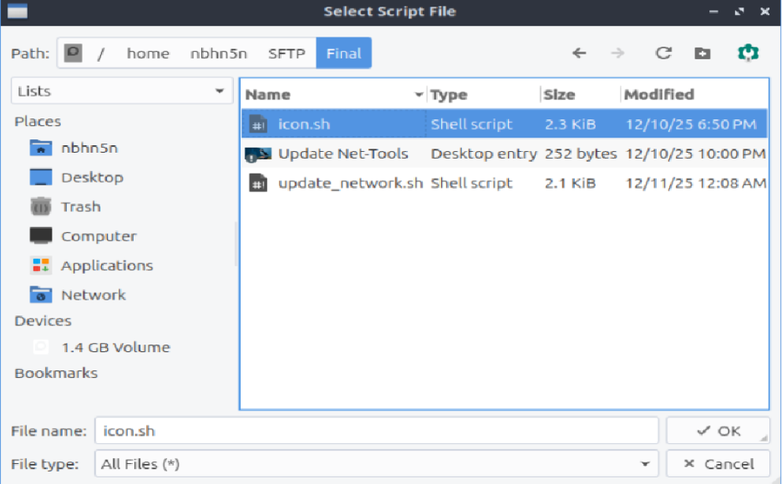
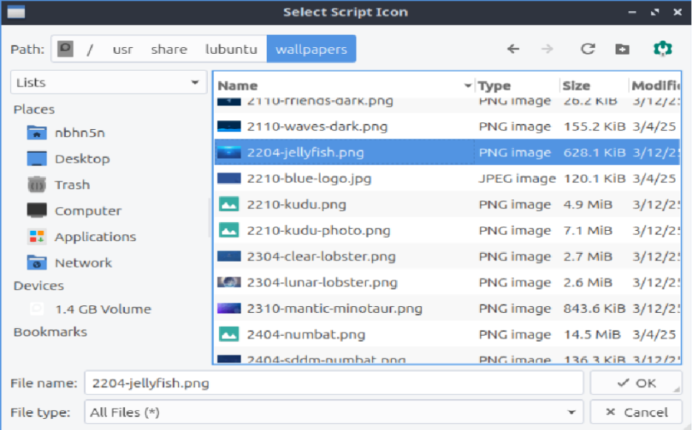
SWOT
COMPANY NAME
icon.sh Demonstration
Asks user for script file via the zenity file explorer:
Asks user for script icon via the zenity file explorer again:

Slide 16
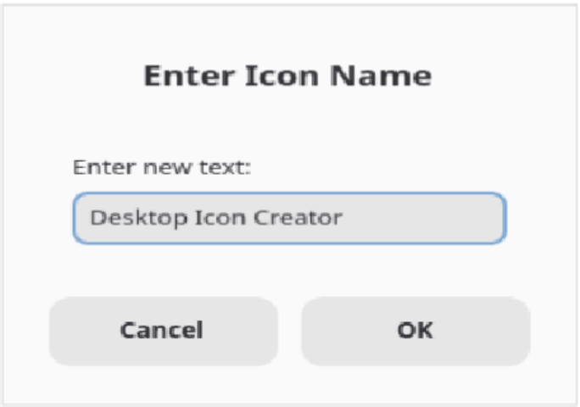
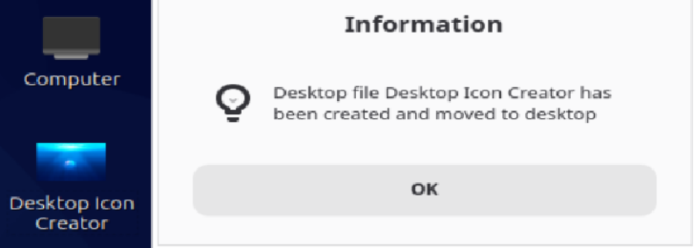
SWOT
COMPANY NAME
icon.sh Demonstration
Then prompts user for icon name through zenity text entry:
Successful creation and copying message is displayed

Slide 17
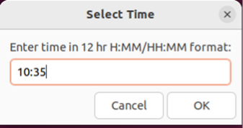
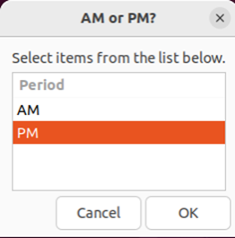
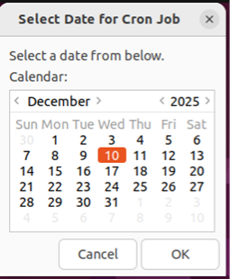
SWOT
COMPANY NAME
cronjobs.sh Demonstration
Calendar picker for selecting the job execution date
Time entry dialog requesting time in HH:MM 12-hour format and AM/PM selection dialog for 12-hour time format

Slide 18
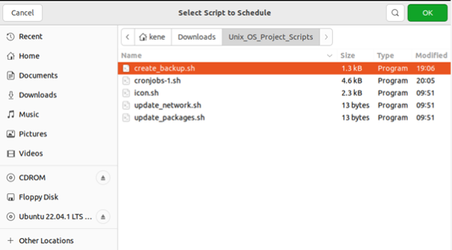
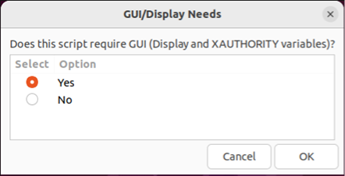
SWOT
COMPANY NAME
cronjobs.sh Demonstration
File browser for selecting the script to execute
Dialog asking if script needs GUI access (for setting DISPLAY variables)

Slide 19
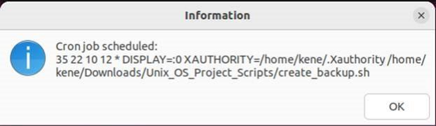
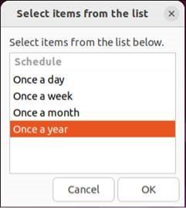
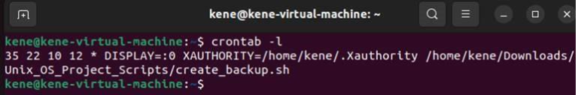
SWOT
COMPANY NAME
cronjobs.sh Demonstration
Repetition schedule options for job recurrence
Final confirmation showing all schedule details and generated cron syntax
crontab -I Output Screenshot:
crontab listing showing the successfully scheduled job (10:35PM on December 10th every year) with proper cron syntax

Slide 20
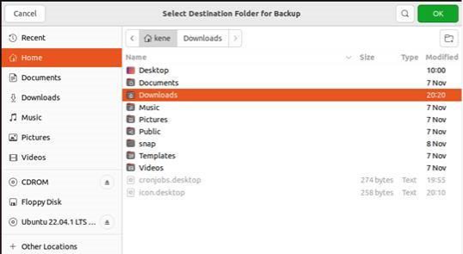
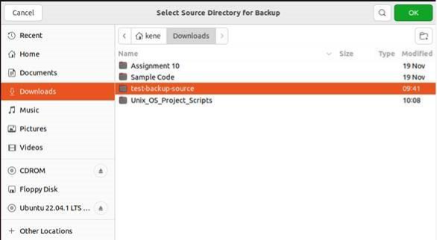
SWOT
COMPANY NAME
create_backup.sh Demonstration
Zenity dialog prompting user to select the source directory to backup
Zenity dialog prompting user to select the destination for where to save the backup

Slide 21
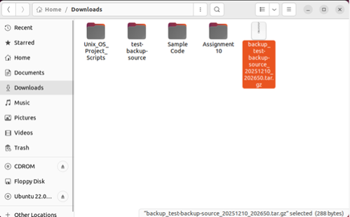
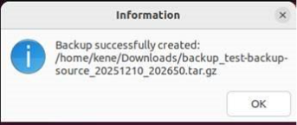
SWOT
COMPANY NAME
create_backup.sh Demonstration
Success notification showing backup was created with filename and timestamp
Backup file created in Downloads with timestamp in filename

Slide 22
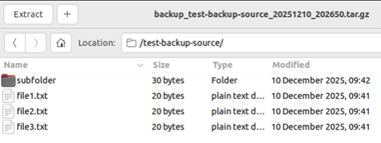

SWOT
COMPANY NAME
create_backup.sh Demonstration
File contents verification - all data matches between original (left) and backup (right)

